Slide 1

Students Attendance Management System
ANISH ROY
ROLL-1909050

Slide 2

Introduction
This project aims to develop an oracle database system for efficient student attendance management, ensuring accurate recording, analysis, and reporting of attendance data to enhance educational institutions' administrative processes and decision-making.

Slide 3
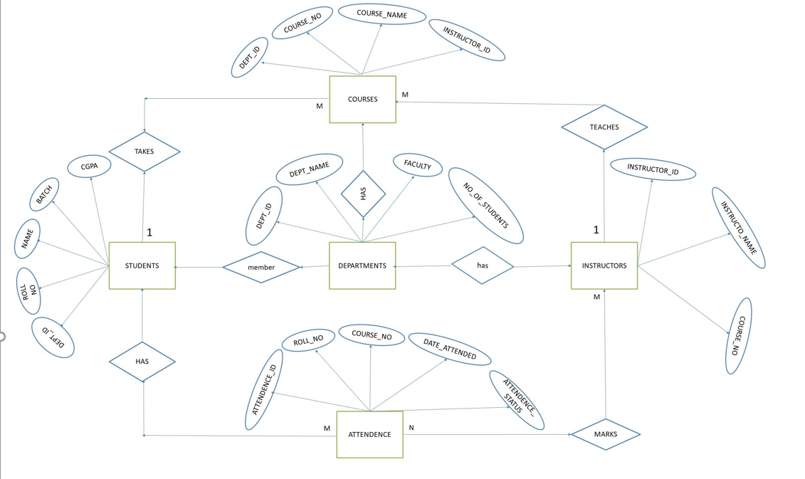
E-R Diagram

Slide 4
DEPT Table
DEPT ID | DEPT NAME | FACULTY | NO OF STUDENT
3 | ECE | EEE | 60
1 | EEE | EEE | 120

Slide 5
STUDENTS Table
ROLL NO | NAME | DEPT | CGPA | DEPT ID
1909050 | ANISH ROY | ECE | 3.4 | 3
1909051 | SHUVA PODDAR | ECE | 4.9 | 3

Slide 6
COURSE Table
COURSE_NO | COURSE_NAME | DEPT_ID
ECE-3207 | Antenna and Wave Propagation | 3
CSE-3209 | Database Management | 3
ECE-3205 | Digital Communication | 3
ECE-3201 | INFORMATION THEORY | 3

Slide 7
INSTRUCTORS Table
INSTRUCTOR ID | INSTRUCTOR NAME | COURSE NO
1234 | MD. BADIUZZAMAN SHUVO | CSE-3209
5678 | SAFIN AHMED | CSE-3209
7847 | EBTIDAUL KARIM | ECE-3105

Slide 8
ATTENDANCE Table
ATTENDANCE ID | ROLL NO | COURSE NO | DATE ATTENDED | ATTENDANCE STATUS
1 | 1909050 | CSE-3209 | 04 -10 -23 | PRESENT
2 | 1909051 | CSE-3209 | 04- 10 -23 | PRESENT
3 | 1909052 | CSE-3209 | 04 - 10 - 23 | PRESENT
4 | 1909053 | ECE-3207 | 04 -10- 23 | ABSENT
5 | 1909054 | ECE-3207 | 04 -10- 23 | ABSENT

